Slide 1
Unit 2
Simplify Square Roots

Slide 2
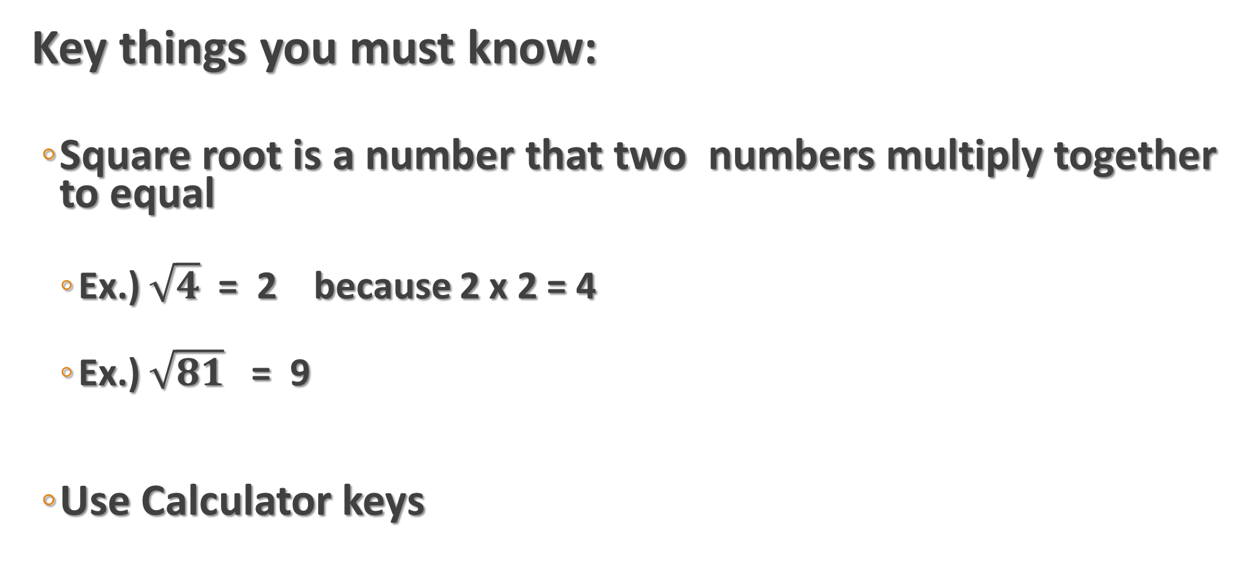
Simplifying Square Roots
Key things you must know:
  Square root is a number that two numbers multiply together to equal
    Ex.) $\sqrt{4}$ = 2 because 2 x 2 = 4
    Ex.) $\sqrt{81}$ = 9
  Use Calculator keys

Slide 3

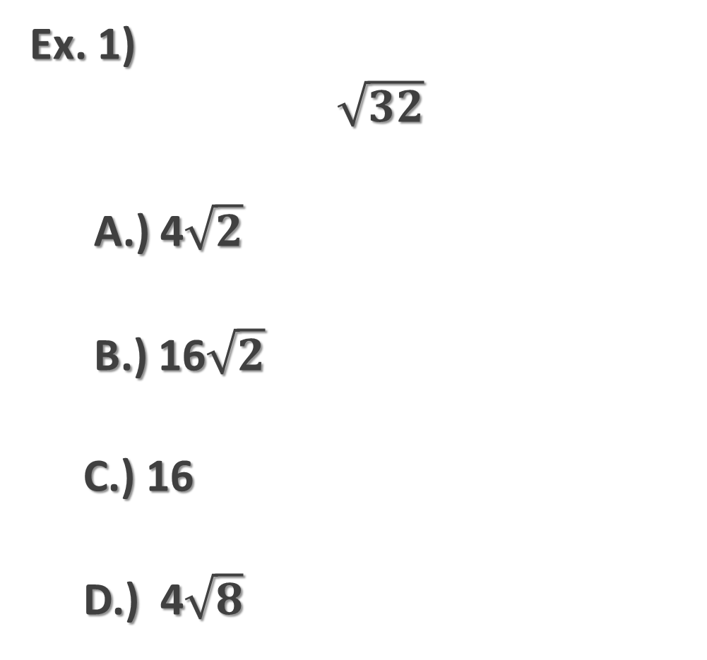
Simplify
Ex. 1)
$\sqrt{32}$
A.) 4$\sqrt{2}$
B.) 16$\sqrt{2}$
C.) 16
D.) 4$\sqrt{8}$
Hit
Enter 32 then hit
Write the decimal by it.
Continue to do this for A, B, C, and D to find the match.
THERE MAY BE MORE THAN 1 MATCH, SO BE SURE TO DO A, B, C, and D!

Slide 4
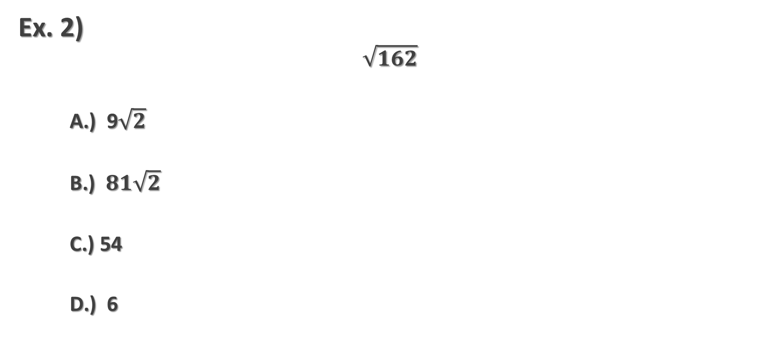
Simplify
Ex. 2)
$$\sqrt{162}$$
A.) 9$\sqrt{2}$
B.) $81\sqrt{2}$
C.) 54
D.) 6

Slide 5

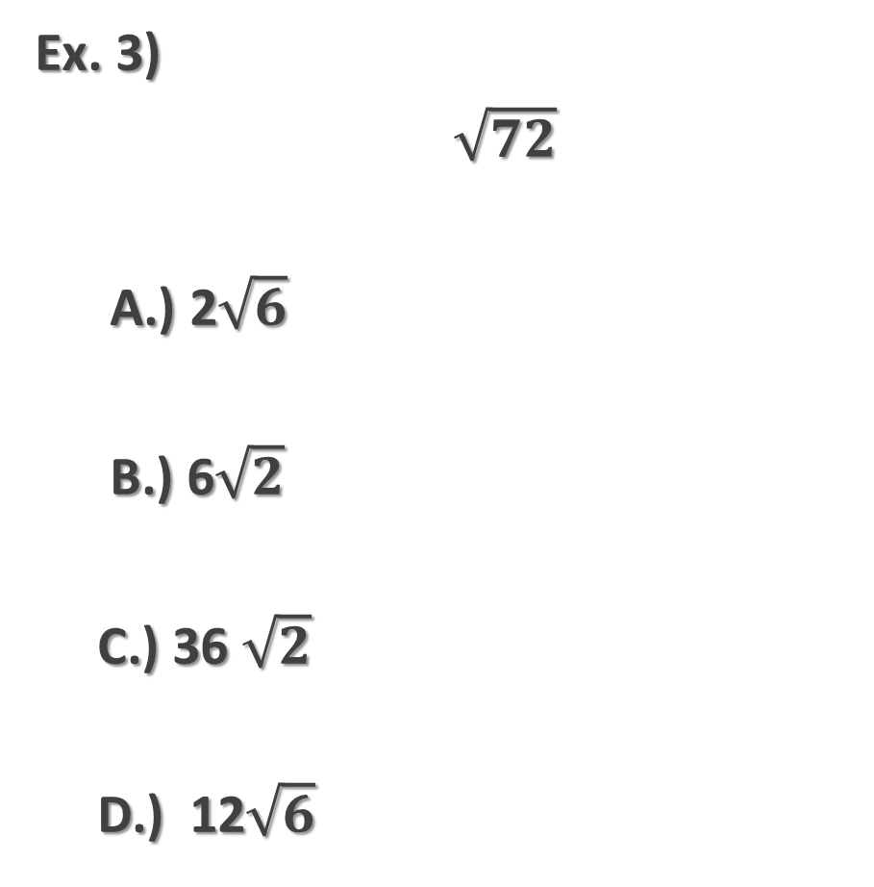
Simplify
Ex. 3)
$\sqrt{72}$
A.) 2$\sqrt{6}$
B.) 6$\sqrt{2}$
C.) 36 $\sqrt{2}$
D.) 12$\sqrt{6}$
Ex. 4)
$\sqrt{605}$
A.) $55\sqrt{11}$
B.) 121$\sqrt{5}$
C.) 11$\sqrt{5}$
D.) $5\sqrt{11}$

Slide 6
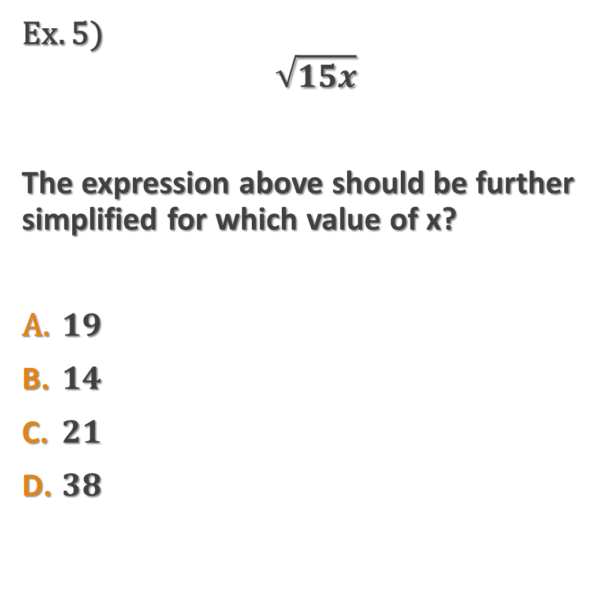
Ex. 5)
$$\sqrt{15x}$$
The expression above should be further simplified for which value of x?
$19$
$14$
$21$
$38$
Find all the factors of the number next to x under square root
  I will show you an easy way to do this.
Take the smallest number (other than 1) and divide it into all the choices.
  If it goes in evenly into one of the choices, that choice is your answer
  If not, continue this process with the rest of the factors.

Slide 7
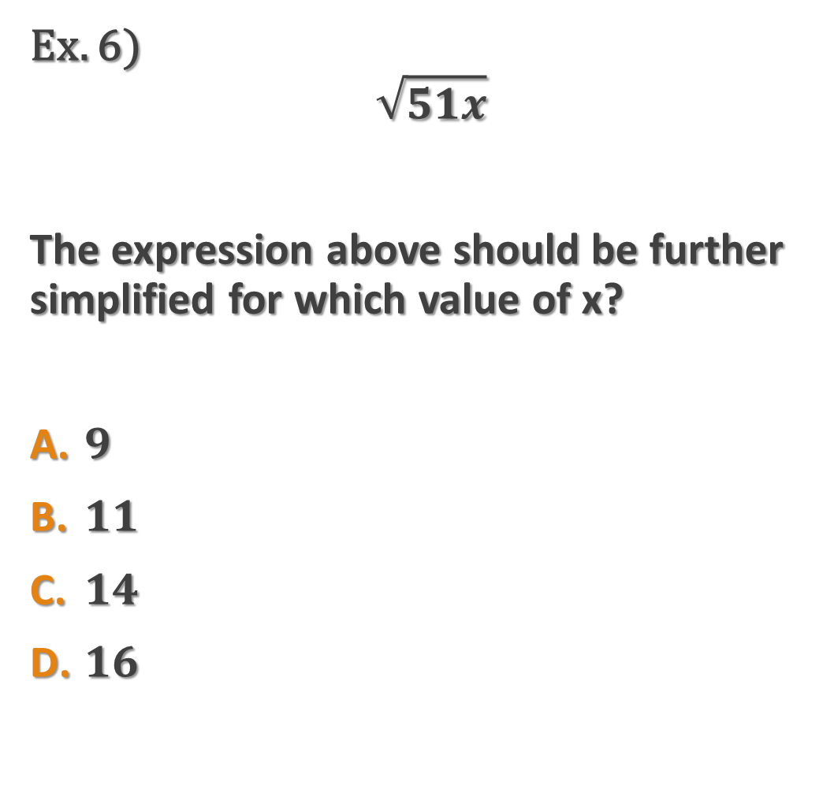
Ex. 6)
$$\sqrt{51x}$$
The expression above should be further simplified for which value of x?
$9$
$11$
$14$
$16$
Find all the factors of the number next to x under square root
  I will show you an easy way to do this.
Take the smallest number (other than 1) and divide it into all the choices.
  If it goes in evenly into one of the choices, that choice is your answer
  If not, continue this process with the rest of the factors.

Slide 8
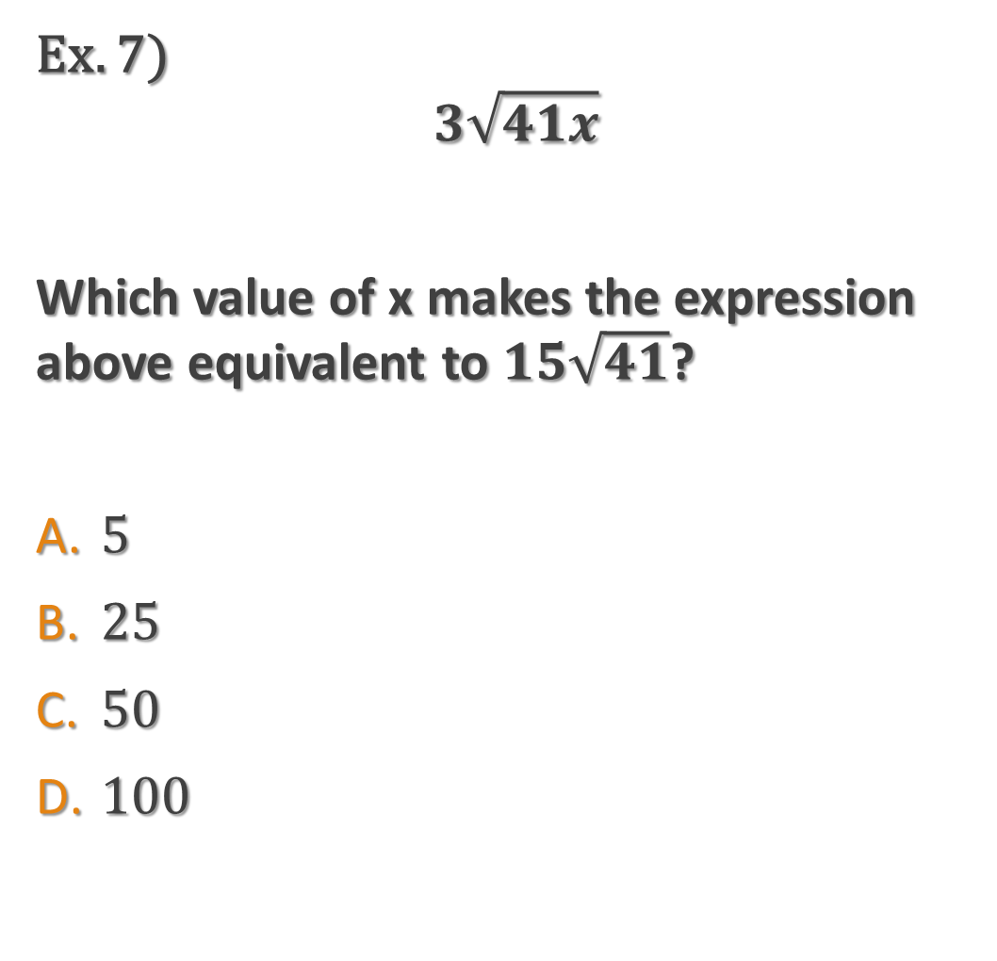
Ex. 7)
$$3\sqrt{41x}$$
Which value of x makes the expression above equivalent to $15\sqrt{41}$?
$5$
$25$
$50$
$100$
Take the number in front of the radical in the question and divide it by the number in front of the radical by the x.
Take that number and square it.
That number is your answer.

Slide 9
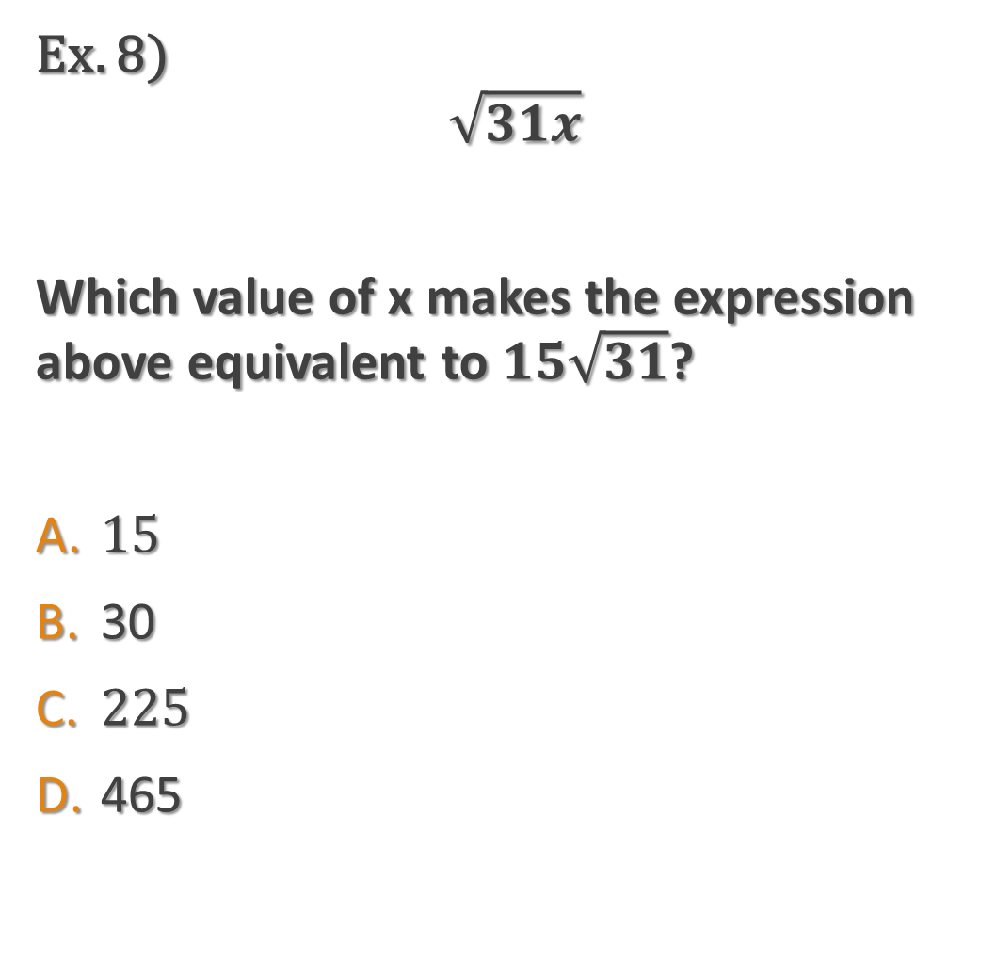
Ex. 8)
$$\sqrt{31x}$$
Which value of x makes the expression above equivalent to $15\sqrt{31}$?
$15$
30
$225$
465
Take the number in front of the radical in the question and divide it by the number in front of the radical by the x.
Take that number and square it.
That number is your answer.

Slide 10
Operations with Square Roots
/
Enter the problem into calculator to find the decimal.
1
Enter the choices into calculator to find the decimals.
2
Find the match.
3
If there is more than one match, go with the smaller number under the square root.
4

Slide 11

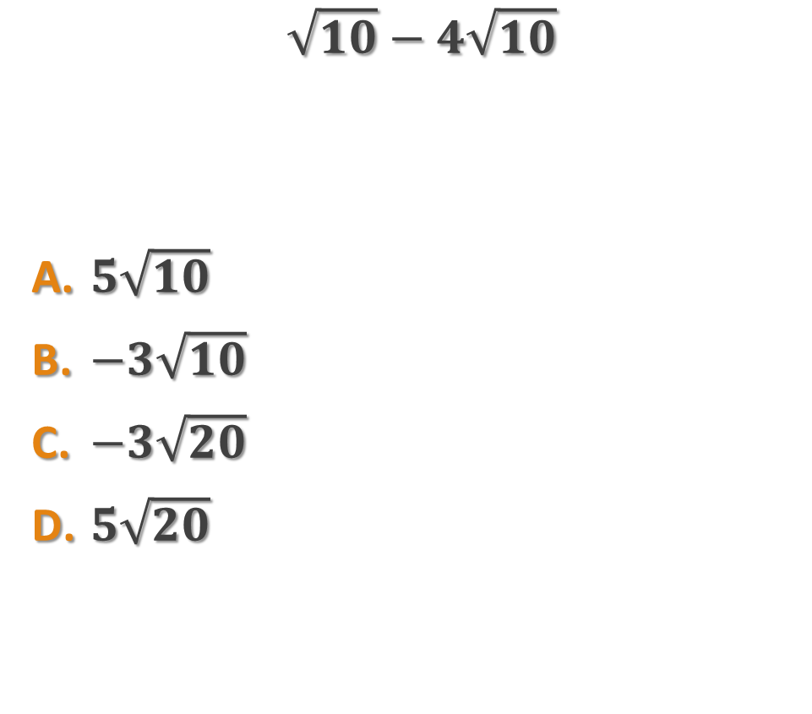
Ex. 9) Ex. 10)
$$\sqrt{10}−4\sqrt{10}$$
$5\sqrt{10}$
$−3\sqrt{10}$
$−3\sqrt{20}$
$5\sqrt{20}$
$$5\sqrt{2}+\sqrt{18}$$
$8\sqrt{2}$
$6\sqrt{18}$
$14\sqrt{2}$
$8\sqrt{18}$

Slide 12

Ex. 11)
$$7\sqrt{7}−2\sqrt{28}$$
$3\sqrt{28}$
$−\sqrt{7}$
$5\sqrt{28}$
$3\sqrt{7}$

Slide 13
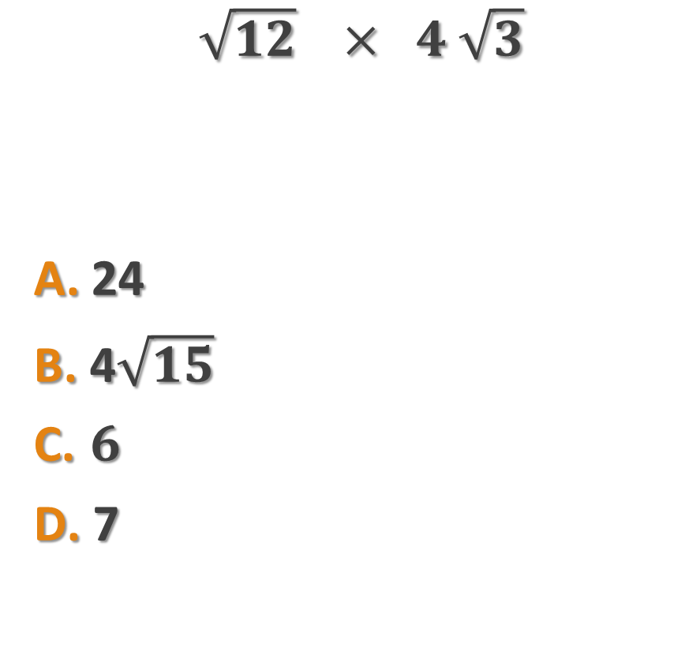
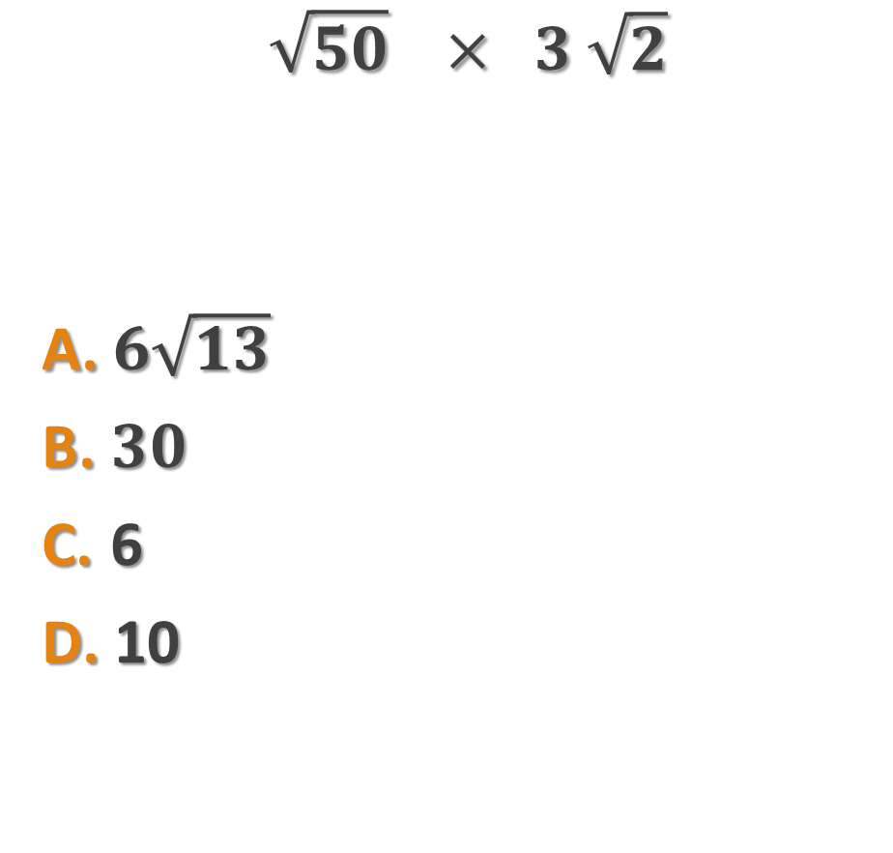
Ex 12.) Ex 13)
$$\sqrt{50} × 3 \sqrt{2}$$
$6\sqrt{13}$
$30$
6
10
$$\sqrt{12} × 4 \sqrt{3}$$
24
4$\sqrt{15}$
$6$
7

